Slide 1
Shaum Series and Leo Garcica

Slide 2
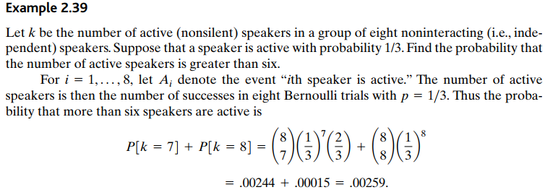

Slide 3
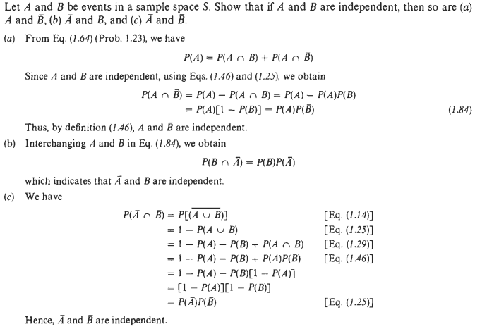

Slide 4


Slide 5


Slide 6

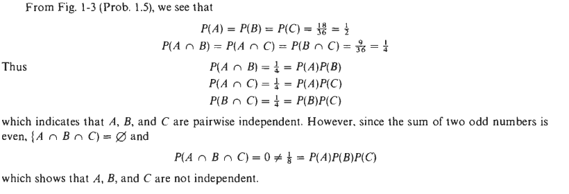

Slide 7



Slide 8


Slide 9


